Slide 1


Class 2022 Orientation

Slide 2
Class 2022 Orientation

Slide 3
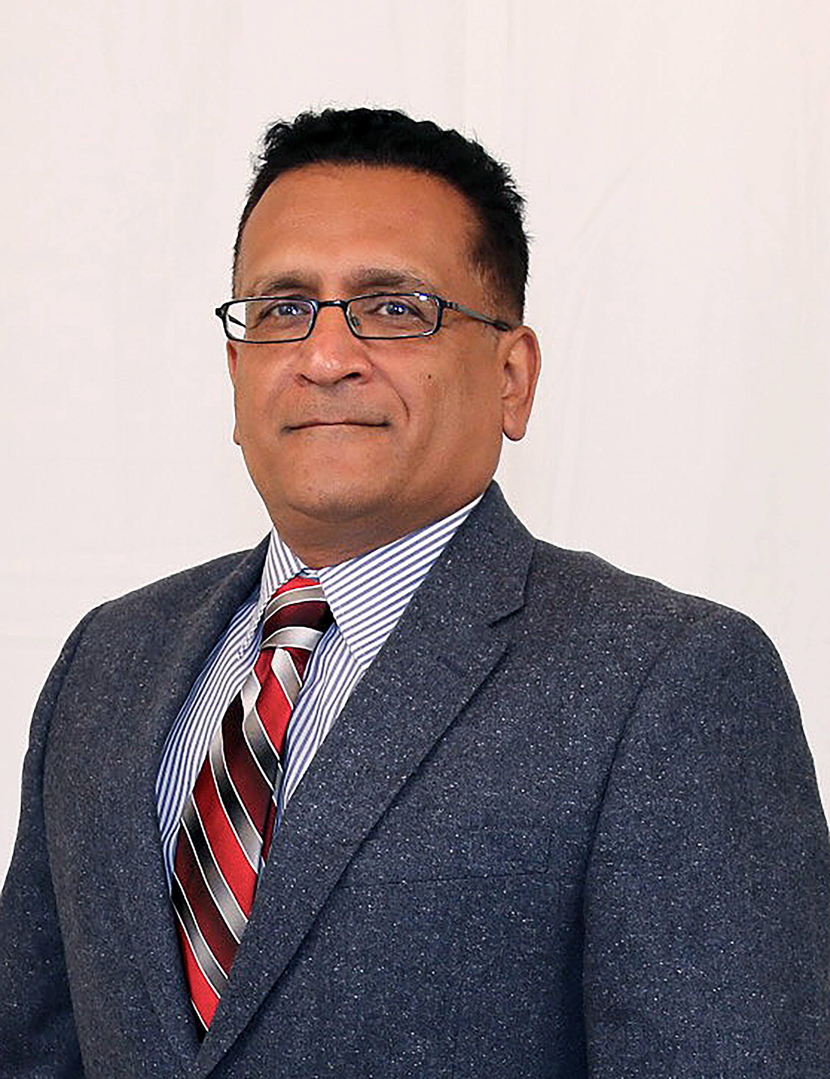

Department Welcome
Dr. Reza Langari
Department Head Engineering Technology & Industrial Distribution
JR Thompson Endowed Chair

Slide 4
Student Introductions
Name
Company
Title
Why METM?
Notes:
Taylor Anderson, Jordan Caddick, Tom Cappucci, Robert Carrano, Roberto Castaneda, Damian Dalcour, Daniel Day, Marc Farias, Jun Gao, Mitch Garrish, Tyler Gilbreath, Brandi Greenberg

Slide 5
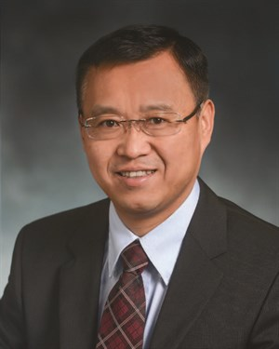
TCMT 612 Technical Management Decision Making
Dr. Xiaomin Yang
Industry Professor
Saudi Aramco
Technology Portfolio Manager

Slide 6
Howdy! from Saudi Arabia
Notes:
Thank you very much Dr. Zoghi for your warm introduction.
Howdy! Everyone. Welcome to the program!
I’m calling in from Saudi Arabia. It’s was around 6pm local time.
2020 is a year full of uncertainty and emotion. I guess everyone has some stressful experience of having to make high-impact decisions under the current unprecedented economic and social environment this year.
The decision making course will help you prepare yourself with a strategic mindset to make unbiased decisions.
Now let me briefly explain what you will learn from the course.

Slide 7
Add a slide of TA
Notes:
Add a a

Slide 8

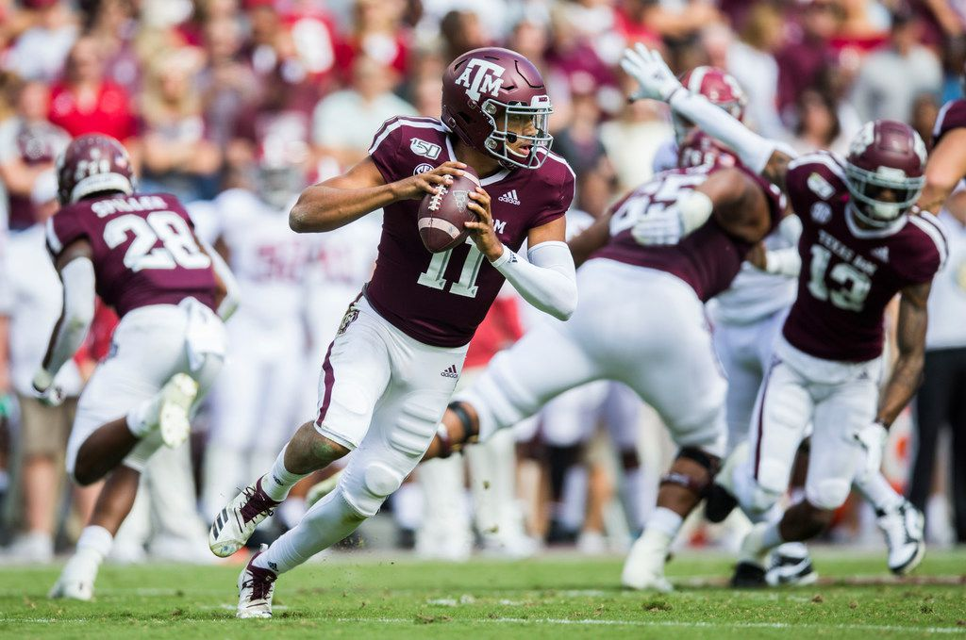

Slide 9
Common mistakes of decision-making
Unclear business guidance
Distracted by past decisions and sunk cost
Drown by data: unclear purpose
Lack of autonomy: too many cooks
Difficult to be decisive and deliberative
Too slow to adapt
Fail to EXECUTE
…
Notes:
Below are some examples of some common mistakes of decision making based on interviews with business leaders and feedback of past students.
Go through the list.
If you agree with some of the mistakes and want to avoid them, this course will serve you well to improve decision-making capabilities.

Slide 10

Systematic approach to decision-making
From this course, You will learn:
You are expected to:
1. Understand competitive strategy
2. Articulate prudent business goals
3. Derive business insights from analysis
4. Evaluate uncertainty and risk
5. Make intuitive judgment
Think as a visionary leader
Able to make informed decisions
Be decisive and unbiased
Notes:
The course is designed around a systematic business decision-making process which include five inter-relative components:
First, understand the strategic direction of a business. Business decisions must be consistent with the strategy. After that, we you learn how to translate the strategy into business goals which your decisions will help to achieve. The first two components will help you to think as a visionary leader. The same principles are also applicable to personal decisions. We should all have long-term personal or career goals and individual decisions shall be consistent with the objectives.
The third component is about deriving business insights from analysis. You will learn some powerful analytical methods, such as business forecasting and optimization. Also, you will learn decision tree tools to evaluate uncertainty and risk. What differentiates this course from other analytics math or engineering optimization courses is that you are expected to be able to use the tools to help make informed decisions based on sights derived from the analysis.
The business acumen and analytical assessment provide you the direction and insights, but the final decision is still made by human beings who can be manipulated by their own and others’ cognitive biases. The fifth component is about how to be decisive and unbiased when facing uncertain and under pressure.

Slide 11

Intuitive judgment
Module 1 – Introduction to Decision Making
Leadership and Management Styles
Module 2 – Intuitive Judgement in Decision Making
Status Quo Bias and, Escalation of Commitment
Module 3 – Intuitive Judgement in Competitive Environments
Win-win negotiation and Negotiation Biases
You will learn:
How to manage intuitive judgment biases
How to apply structure and process to negotiation
Notes:
We organize the flow of the components to maximize your learning experience and efficiency.
The first three modules are about intuitive judgment to give you the opportunity to develop self-awareness of your leadership style and psychological behaviors. I put these intuitive judgment modules at the beginning of the course so that you will have the time to practice, develop and shape the leadership and influencing skills.
1, 2 3,

Slide 12
Decision-making under uncertainty
You will learn:
How to develop decision tree models
How to incorporate risk tolerance into decision analysis
Module 4 – Data Driven Decision Making
Visualize uncertain scenarios
Make calculated choice
Justify risks (conservative vs. gambler)
Communicate decisions to motivate team
Notes:
After understanding psychological behaviors to make unbiased judgment calls, you will learn how to use analytical tools to make date-driven decisions under uncertain situations.
The module will cover the following topics.
Explain your rationale and thought process to other team members to create buy-in and motivate them to execute the decisions to achieved the desired outcome.
Last year, one student used the tool at his work place.

Slide 13

Align decision with business strategy
Module 5 – Align Decision with Business Strategy
Cost Leadership and Differentiation Strategies
Module 6 – Measure Business Performance
Financial Performance and Strategy Alignment
You will learn:
The secrets of industry profitability and competitive advantages
How to set strategic objectives and performance criteria
Notes:
Modules 5 and 6 are condensed versions of two core MBA topics, business strategy and financial performance.
In module 5, you will learn the secrets of industry profitability and business strategy. Each business need to have a clearly-defined strategy to grow and thrive in a competitive environment. All the other business decisions must be consistent with the strategy.
From module 6, we you learn how to translate the strategy into business goals which your decisions will help to achieve.

Slide 14

Data-driven decisions
Module 7 – Business Forecasting
Moving Average Method and Seasonal Analysis
Module 8 –Business Optimization
Business Analytics to Transform Decision Making
Demand / Production Planning and Inventory Optimization
You will learn:
Build forecasting models to predict performance of a business
Draw business insights from optimization analysis
Requirement:
Personal computer (with MS Window)*
MS office (offline version installed on PC) *Analytics software not completely compatible with MAC
Notes:
In recently years, data-driven decisions have been widely adopted by industry as the results of business process and operations workflow digitalization.
Module 7 will cover business forecasting, how to build predict the market demand and, more importantly, business performance.
From Module 8, you will learn optimization models to analyze the business operations and therefore draw insights from the analysis The course will use a couple of cases, such as finance and operation optimization analysis to help you master the data-driven decision making principles.
An MS EXCEL add-in software program called Analytisolver will be used and a license will be distributed early September.
Each student is required to have personal computer with MS Windows and MS office off-line installed on your PC. TAMU offer student license of the MS office. The software isn’t completely compatible with MAC, so a PC is required.

Slide 15
Add a slide of materials
Textbooks
Software
Read materials
Self assessment
Negotiation projects
Quiz
Assignments
Simulation
Final exam
Discussions

Slide 16

Have fun & enjoy the new journey!
Notes:
In summary, your next 20 months will be overwhelming, productive and awarding.
My first expectation on each of us is to have fun and enjoy the new journey.
Thank you!

Slide 17
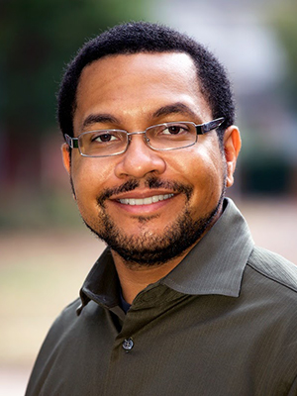
TCMT 613 Technical Project Management
Prof. Michael Handy
Industry Professor
National Instruments
Engineering Section Manager

Slide 18
TCMT 613 Technical Project Management

Slide 19
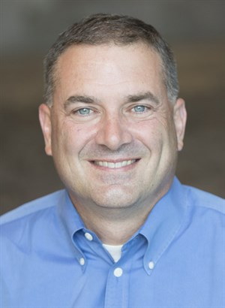
TCMT 623 Financial Decision Making
Prof. Marc Marini
Industry Professor
National Instruments
Director of Research & Development, DAQ & Control

Slide 20
TCMT 623 Financial Decision Making

Slide 21
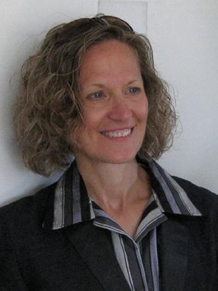
TCMT 624 Managing Technical Teams
Prof. Lisa Spence
Industry Professor
NASA Deputy Element Manager (Retired)

Slide 22
TCMT 624 Managing Technical Teams

Slide 23
Break

Slide 24
Student Introductions
Name
Company
Title
Why METM?
Notes:
Jay Hembree, Amy Hollabaugh, Matthew Hudson, Christopher Huebel, Ronnie Hurst, Timothy Koontz, Dinah Logan, Jacquelyn Lopez-Barlow, Jeremy Meehleib, Travis Metz, Kassie Mobley, John Mullins

Slide 25
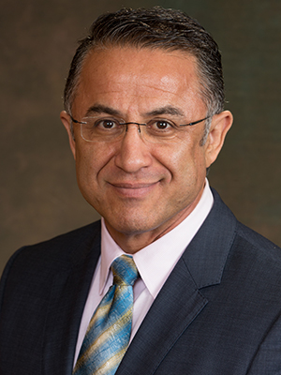
TCMT 619 Personal Leadership Coaching
Dr. Ben Zoghi
Founding Director Master of Engineering Technical Management
Victor H. Thompson Professor

Slide 26
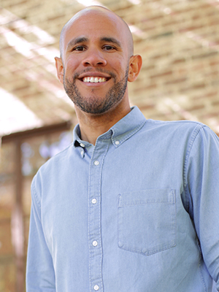
TCMT 619 Personal Leadership Coaching
Prof. Bryan Anderson
Industry Professor
Anderson & Anderson
EQ Coach

Slide 27
TCMT 619 Personal Leadership Coaching

Slide 28
Lunch Break

Slide 29
Student Introductions
Name
Company
Title
Why METM?
Notes:
Kacie Olson, Bill Osburn, Mariano Paoli, Tim Parker, Richard Pearson, Carolyn Perez, Kaleigh Philips, Troy Philips, Rosanna Popa Rangel, Logan Presnall, Joseph Ramirez, John Schaub

Slide 30
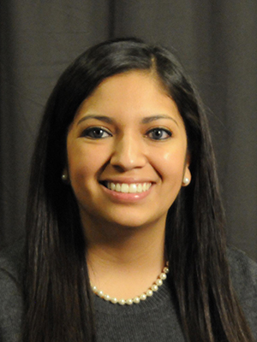
Introduction & When to Contact
Ms. Leslie Ehlers
Assistant Director Master of Engineering Technical Management

Slide 31
Class President
Selected during Residency Week
Class Decision: Select in August or December?

Slide 32
Social Media
Facebook | Class Owned
LinkedIn | METM Owned

Slide 33
Student Handbook
University Resources
METM Student Expectations & Policies
Steps for Success
Faculty & Staff
Student Rosters

Slide 34
Degree Plan
August 18 Deadline
Step-by-Step Instructions

Slide 35
Break

Slide 36
Student Introductions
Name
Company
Title
Why METM?
Notes:
Grant Shirley, Jeremy Smith, Zachary Smith, Daniel Talamantez, Sarah Terrill, Harshvardhan Tirpude, Kenneth Wagner, Megan Wallace, Jonathan Weiss, Tanner Welch, Joe Williams, Eric Worley

Slide 37
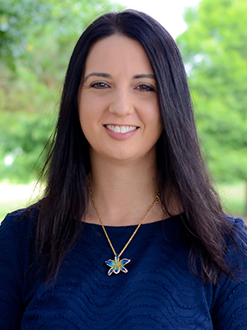
Introduction & Research Opportunities
Dr. Michele Norton
Postdoctoral Research Associate Master of Engineering Technical Management

Slide 39
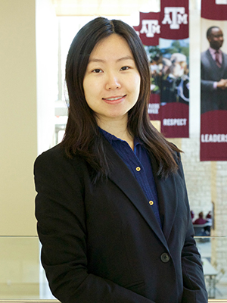
Introduction & When to Contact
Dr. Wei Lu
Curriculum Manager Master of Engineering Technical Management

Slide 40
Canvas Navigation

Slide 41
Canvas Q&A

